Slide 1
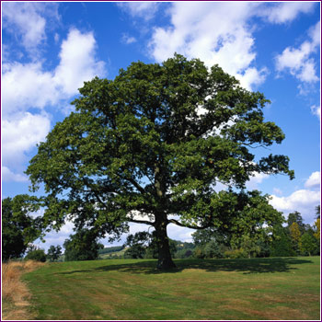
Oak Tree Day Nursery, Amington Branch
Heather

Slide 2
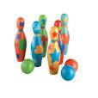
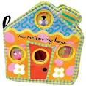
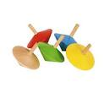
The Nursery set up…
Three rooms, equipped for specific age group
Toys cleaned regularly and thrown away if showing signs of wear.

Slide 3
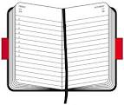
Baby room
Eighteen babies aged between 0 and 18 months.
Room divided into two sections, walkers and non walkers.
Various activates
Daily diaries

Slide 4
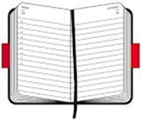
Tweenie room
15 children aged between 18 months – 2 and a half years.
Various activities
Daily diary

Slide 5
Pre-school
children from 2 and half - 5 years.
Various activities
activities ensure each child achieves learning outcomes from all of the six areas of learning.
Daily diaries

Slide 6
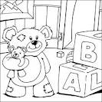
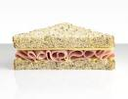
Typical day…
arrive at the Nursery for 3pm
help children complete current activity e.g reading, colouring, going outside
At around 4pm I would help tidy up and set up for Tea.
‘child's choice’ play
Picked up between 4-6

Slide 7
Skill development
Independent enquirer- taking responsibility for planning what to do and how to go about it
Creative thinker- asked more questions in order to gain understanding of the task.
Reflective learner- Asking for feedback and dealing with it positively and constructively.
Team work- Working confidently with others and to resolve issues.
Self-manager- coping with new challenges and opportunities.
Effective participator- playing and taking a full part in work

Slide 8
Independent enquirer evidence…
‘Taking responsibility for planning what to do and how to go about it’
Employee comment- “Heather has led activities within the different age sections of the nursery independently and with initiative”

Slide 9
Creative thinker
‘Asked more questions in order to gain understanding of the task.’
Employee comment- “Heather is not afraid to ask for guidance if she is not sure what to do.”

Slide 10
Reflective learner evidence…
‘Asking for feedback and dealing with it positively and constructively.’
Sometimes when talking to the children they would not listen and carry on behaving disruptively, the staff would tell me I need to be more confident and enforce the rules so that the child understands and listens to me. I feel that I took on board what the staff said and am now much more confident when talking not only to children but adults aswell.

Slide 11
Team work evidence…
‘Working confidently with others and to resolve issues.’
Mrs Thompson- “Heathers supervisor informs me that she always uses initiative and can work well as part of a team or independently. She is good at following instructions but also can access the needs of the children and what may benefit staff. An example of this is when a child falls over Heather attends to the child without being prompted”

Slide 12
Self-manager
‘coping with new challenges and opportunities.’
Mrs Thompson- “Heather was the first student to organise her work experience and has behaved in a mature way since the start of enrichment.”

Slide 13
Effective participator
‘playing and taking a full part in work’
Employee comment- “Heather has made a valuable contribution whilst she has been here and the children have shown an improvement in their cognitive skills since they have been working with Heather. We are really pleased with what Heather has achieved whilst being on placement.”

Slide 14
Highlights of placement
Boy joined, speech severely behind
Constantly cried, wouldn’t join in
After a few weeks staff gained his trust and he began to join in.
His speech slowly improved over the weeks and he can now have a basic conversation and plays nicely with peers.

Slide 15
What did I least enjoy?
Tidying up after messy activities
Uninteresting jobs (washing up etc…)

Slide 16
Comments;
Heather describes herself as “an extra pair of hands.” Her supervisor describes her as “brilliant”
“Heather is helpful, interacts well, uses her initiative and is very punctual.”
“Heather has been great whilst she has been here, she has really helped out a lot and the children love her. We would have another work experience student here after Heather because she has done a fantastic job.”

Slide 17
Future career plans…
University to study social work
Progress into child protection
I formed strong relationships with the staff and children and this will benefit me as a Social worker when working with families and co-workers.
I understand the need to keep children's identity confidential for child protection as I will have to in my chosen career.
I have learnt to accept someone's opinion even if I don’t agree and this will benefit me greatly when dealing with cases as social workers should be non-judgmental.
I was able to work in both large and smaller which will benefit me in my chosen career when dealing with cases.

