Slide 1

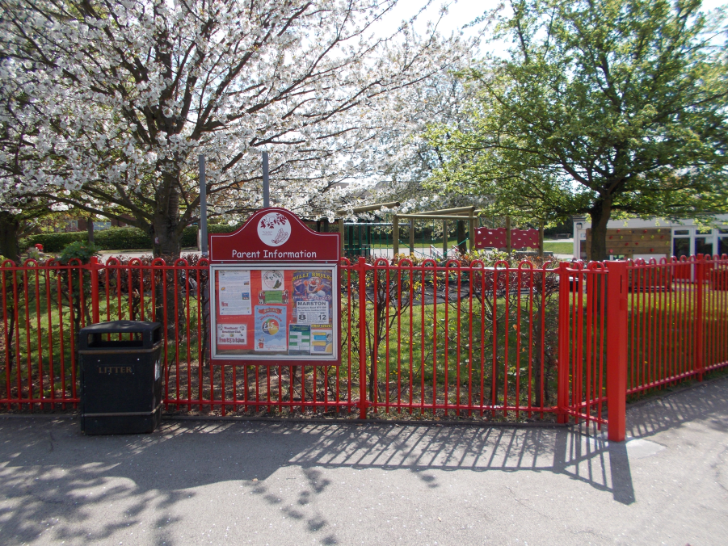
Woodlands Community Primary School

Slide 2
My roles and responsibilities
I worked with a Year 3/4 class.
Assisting the teacher in preparing materials.
Sat with different tables, helping them with their topic work and science work.
Responsible for teaching a small group of children, helping them to carry out scientific experiments.
Listening to and helping develop reading skills of individuals.
Encouraging and monitoring children’s behaviour.
Motivating and working with children with mild learning difficulties.

Slide 3
What skills did I learn?
Communication skills- listening and using appropriate ways to explain things to children of that age.
Alternative methods- Finding different ways to deliver information so everyone in the class understood what was being taught.
Effective time management and organisation- having lesson plans and resources created well in advance.

Slide 4
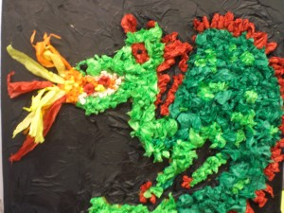
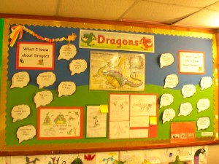
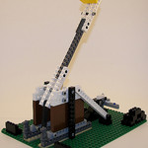
What did I enjoy?
Seeing the group learn something new from what I had explained.
Helping to improve the confidence of the lower level readers in the class.
The practical side, including carrying out scientific experiments and making Lego catapults and dragons!
Having a bit more responsibility towards the end of my placement.
The appreciation from the class and from the teachers for my help.

Slide 5
What did I not enjoy?
Some afternoons they were doing tests or assessments and so there wasn’t much I could do on those days.
Going on the same afternoon every week so they were always doing the same lessons- not much variety.
Hard to deal with the children who didn’t have very good concentration levels.

Slide 6
Applying the skills
Using different ways to communicate with different people and different age ranges.
Appreciating the different ways in which people learn and take in information.
Dealing with stressful and difficult situations.
More independence- using my initiative when I’m unsure in a situation.
Organisation can be used across all aspects of life- school, home etc.

Slide 7



My future plans
This work experience has allowed me to gain a good insight into the teaching profession.
Realisation of the commitment teachers need to have, including out of school hours.
Looking into doing Primary Education at University.
Realising that, although it is a stressful job, it can also be extremely rewarding!

Slide 8

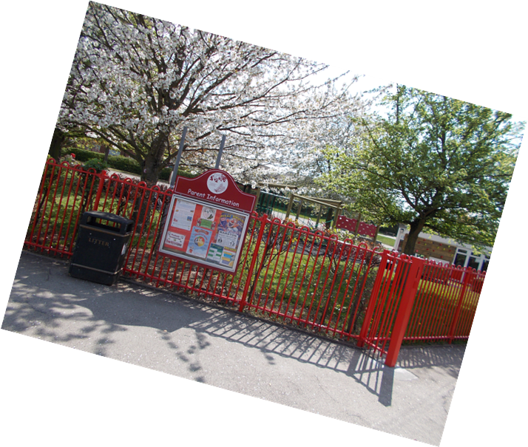
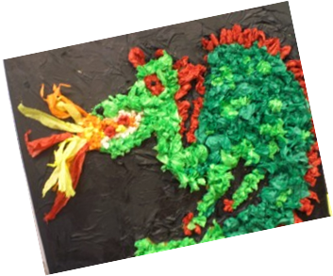
Thank you for listening!
Any questions?

