Slide 1
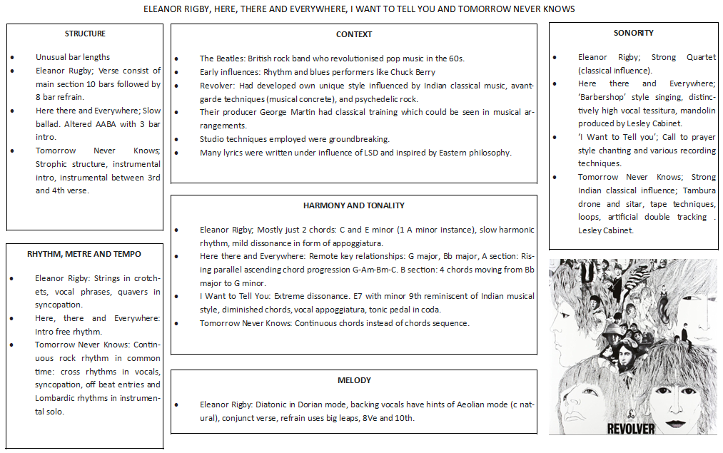
A level MUSIC—Area of study 4: Popular Music and Jazz

Slide 2
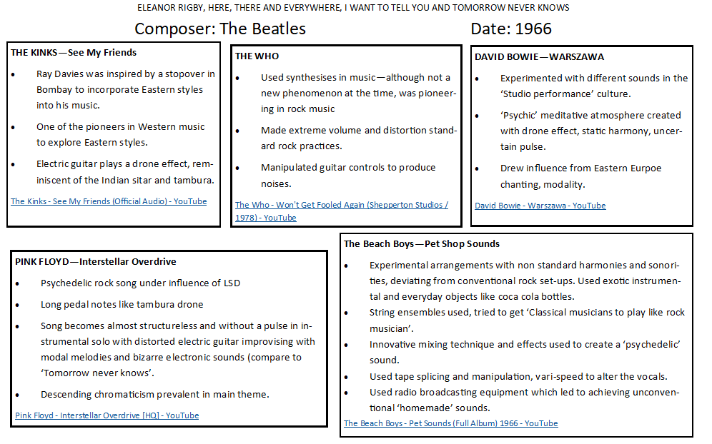
A level MUSIC—Area of study 4: Popular Music and Jazz

